Slide 1
Pranav wanne’s digital portfolio
PRN:-202501040329 DIV:-CS3 Batch:-C34 COURSE:- PR01

Slide 2
INTRODUCTION
Hello, I’m Pranav Wanne. Welcome to my portfolio presentation. Here, I’ll be sharing my skills, interests, and the knowledge I’ve gained through my learning journey. This portfolio reflects my interest in technology and my continuous effort to improve and grow.

Slide 3
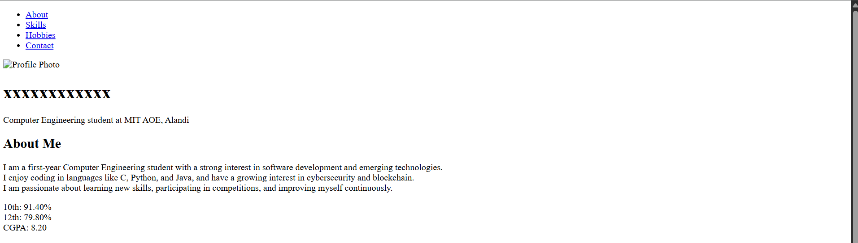

Slide 4
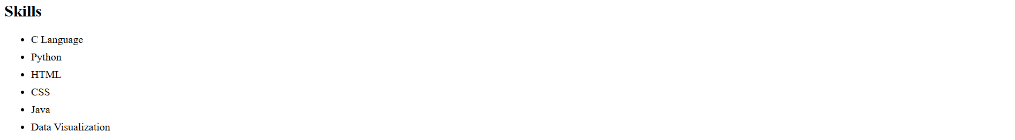

Slide 5
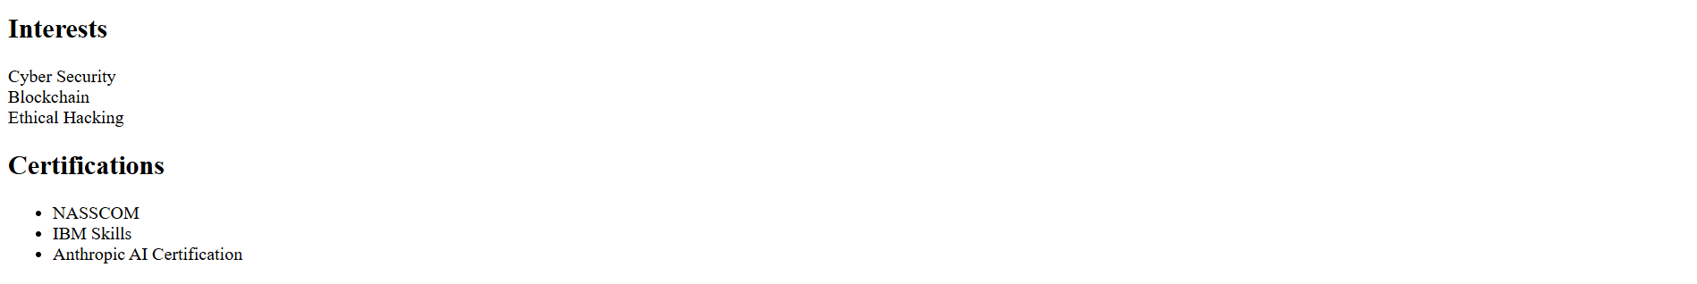

Slide 6


Slide 7
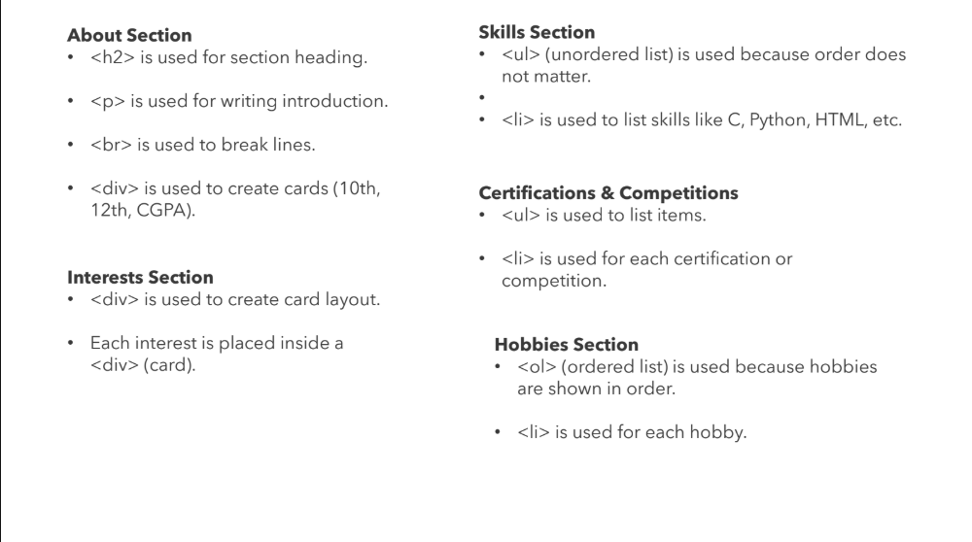

Slide 8
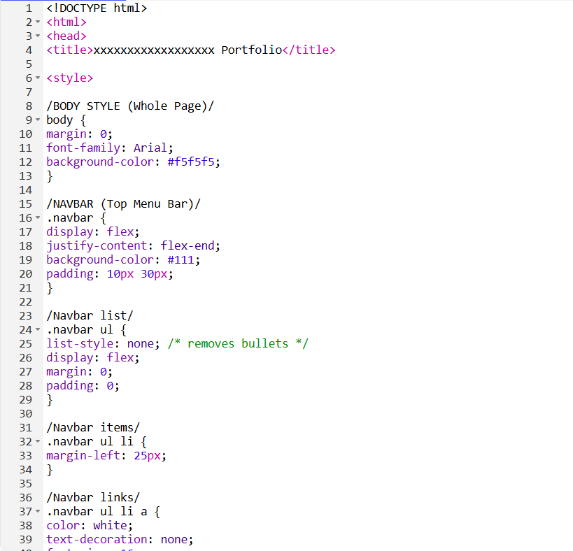
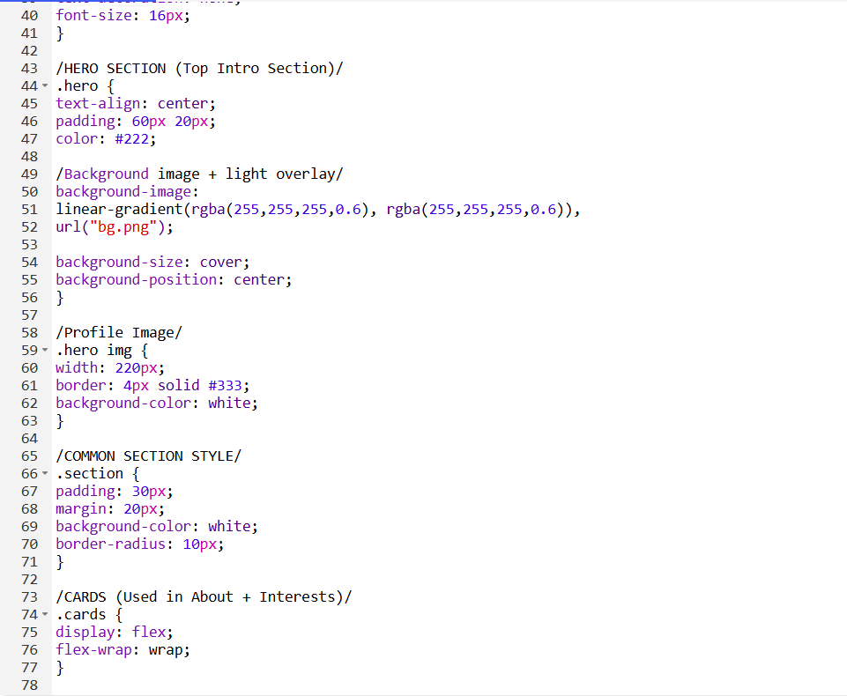

Slide 9
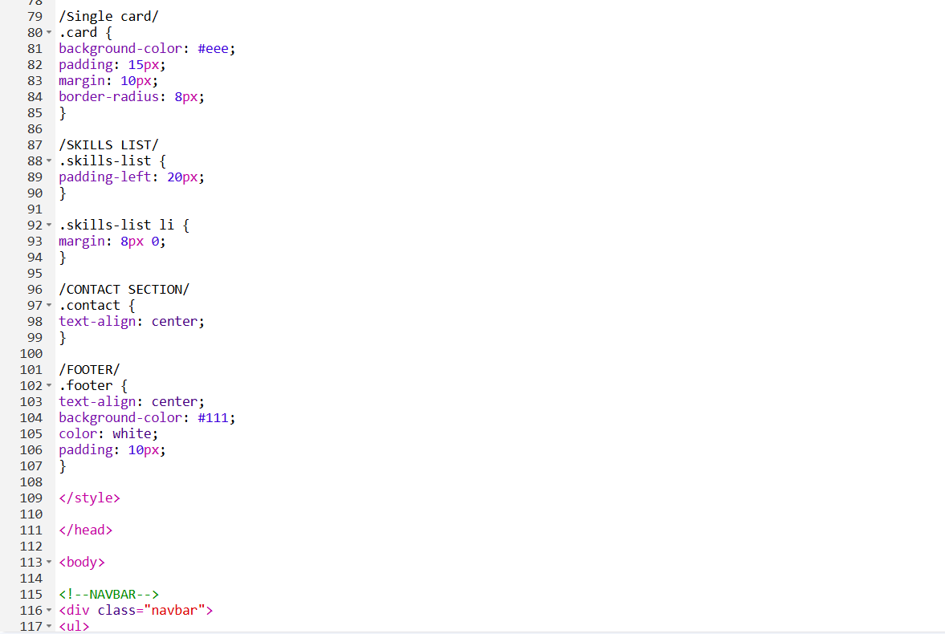
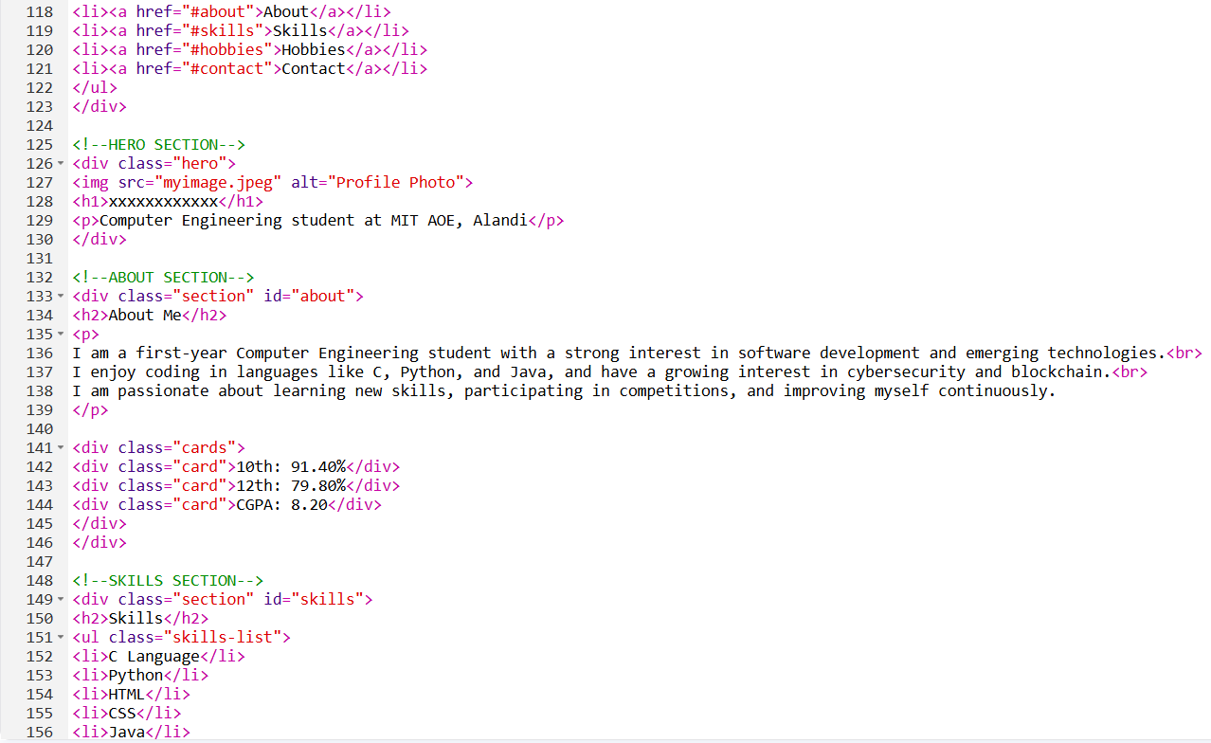

Slide 10
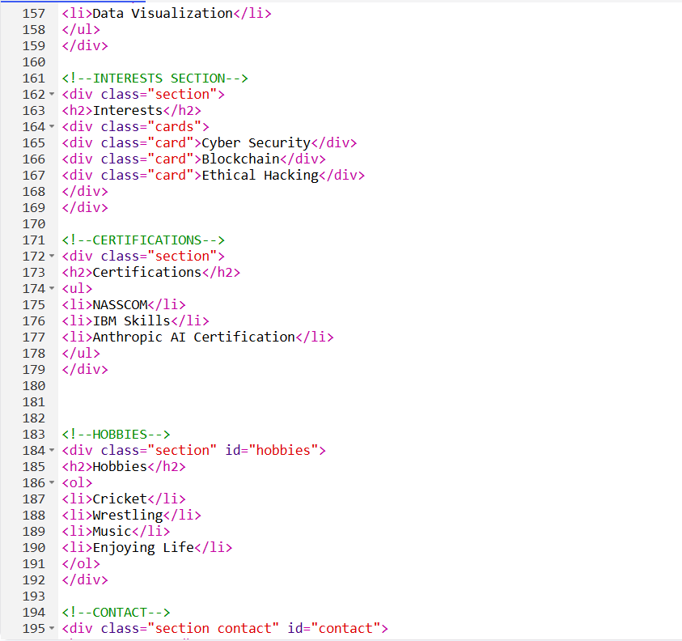

Slide 11


THANK YOU
This Photo by Unknown Author is licensed under CC BY-NC

